Slide 1
Analysis of sub metering using Automated smart home device for energy consumption management
By
Akano, Keside.K
Data Analyst

Slide 2
AGENDA
DISCOVERY
INSIGHT
OUTCOMES
RECOMMENDATION

Slide 3
BACKGROUND
BUSINESS INSIGHS
CUSTOMERS SATISFACTION , COST AND REVENUE
To identify customers needs to make more sales per customer.
Traffic charge reduction to the optimal minimum.
Cost benefit ROI analysis of planned strategy.
Develop pricing strategies to acquire market share.
Identity productivity improvement areas.
Build optimal resource deployment to implement to implement strategy.

Slide 4
GOAL AND OBJECTIVE
To make a data driven decision on how smart home can control and regulate Sub-metering energy consumption in house appliances and to achieve sustainability through accountability.

Slide 5
DATA MANAGEMENT
Data management. Data is the new currency in today’s digital economy so how you manage it is very important. Data collection, archiving and storage system are key major parameter. I will suggest cloud management architectural system. Data stored in the cloud has data integrity and security.

Slide 6
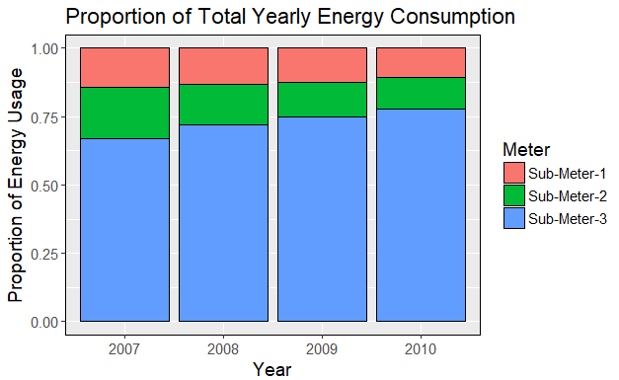
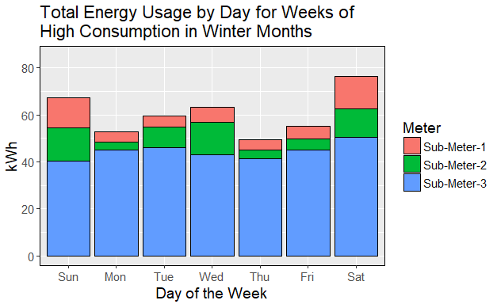
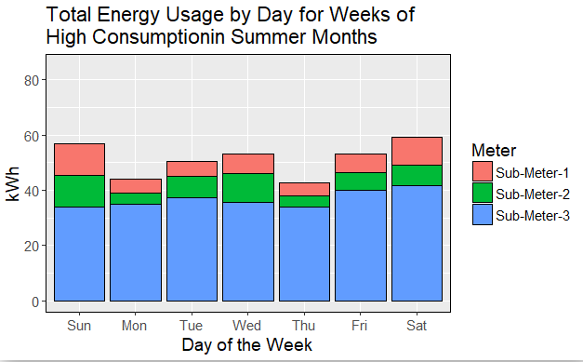
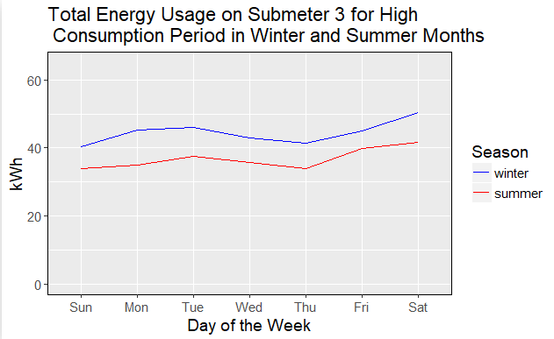
DISCRIPTIVE ANALYSIS ON SUB-METERING

Slide 7
recommendation
USING INTERNET CONNECTED DEVICE TO MONITOR AND REGULATE ENERGY CONSUMPTION IN SUB-METERS OF HOME APPLIANCES.
INSTALLING RENEWABLE SOLAR PANEL .
IDENTIFICATION OF PEAK ENERGY AND OFF PEAK USAGE OF BEHAVIOR, AND TAKE ADVANTAGE OF ELECTRICITY RATES.

